Slide 1
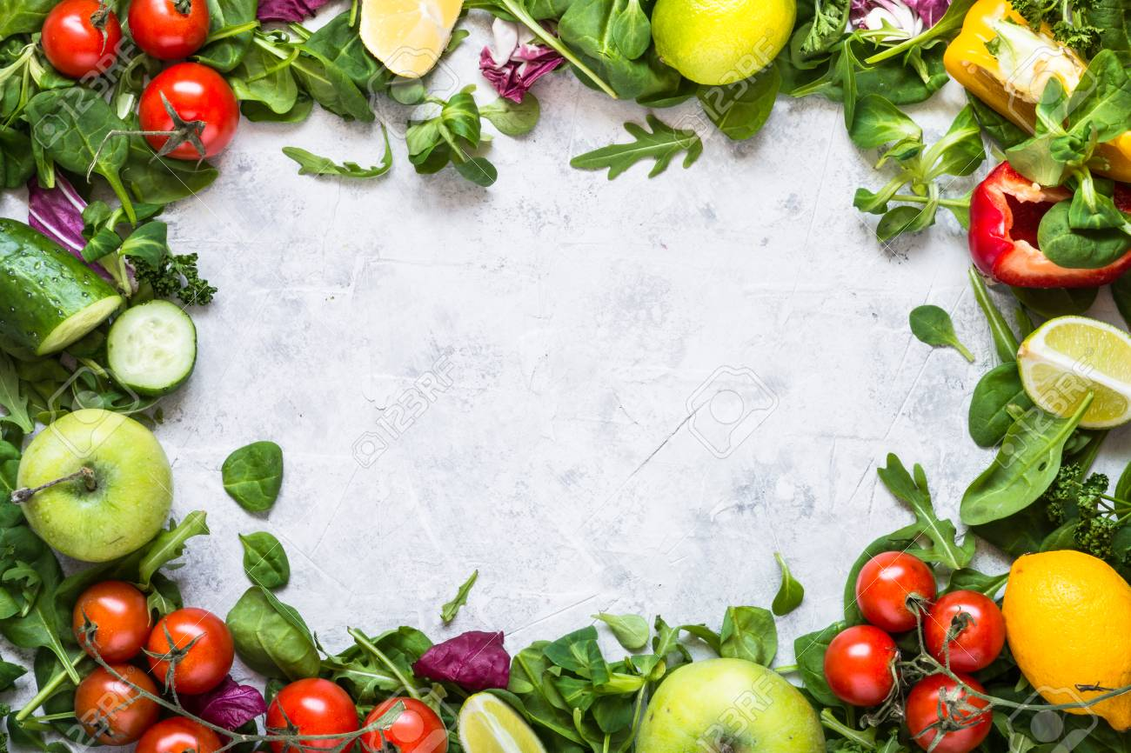
La Cuisine Restaurant

Slide 2
Hello!
I am Muhammad Asif Ayub
Assad Ullah Khan
2

Slide 3
Contents
01
Introduction
02
Entity Description BR
03
ERD
04
Normalized Relational Schema
3

Slide 4
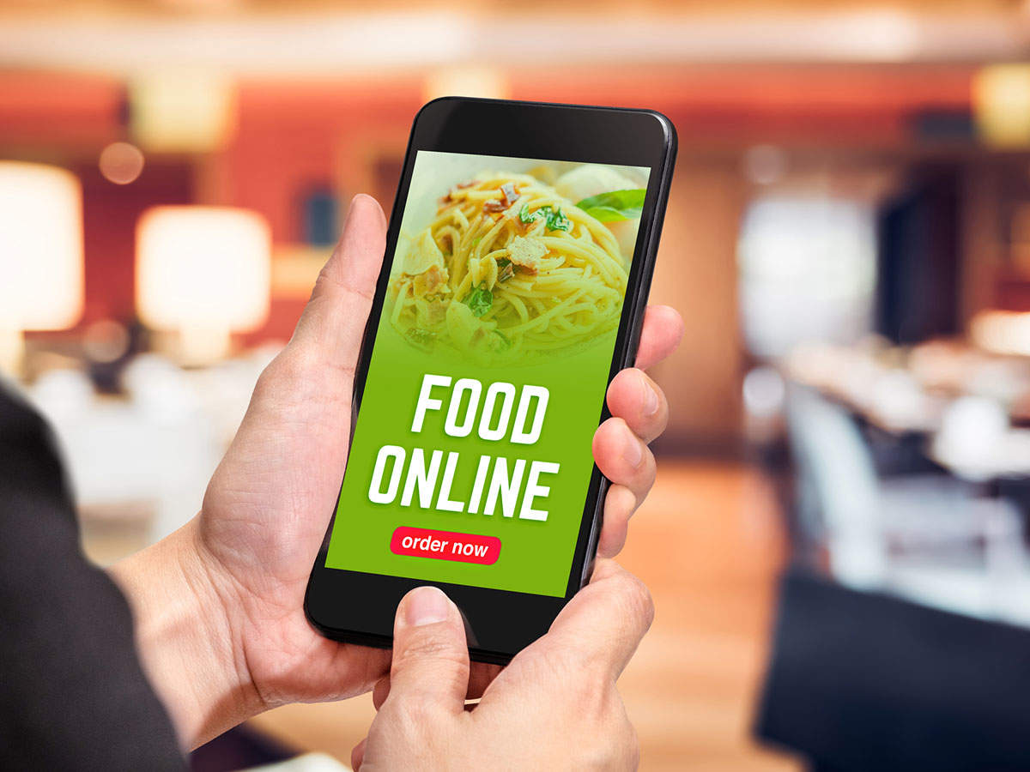
Introduction
La Cuisine Restaurant is located in DIKhan since 2006, having the specialty of Pakistani and Chinese foods.
La Cuisine is focusing on providing online services to its customers including online order booking, takeaway or home delivery option for online customers, to see our menu so they can easily select and order within there comforts.
New customers can easily track the location and contact with us.
4

Slide 5
Entity Description
1
Users
4
Food
2
5
Customers
Food_Image
3
6
Orders
Category
5

Slide 6
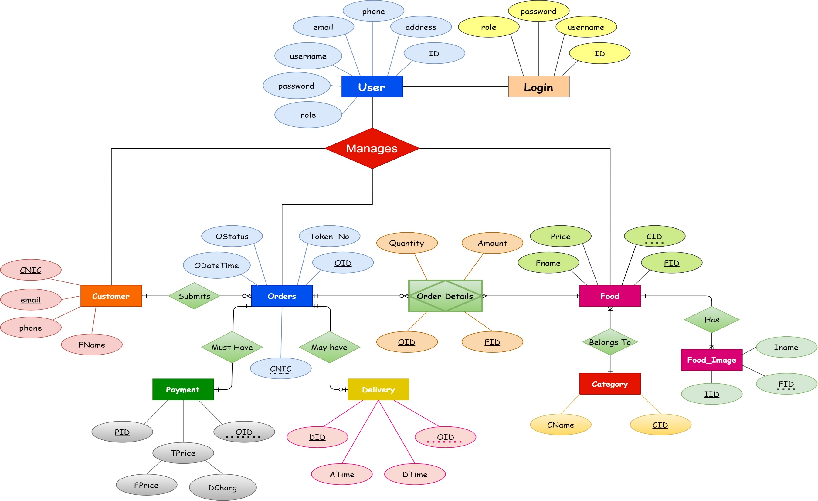

Slide 7
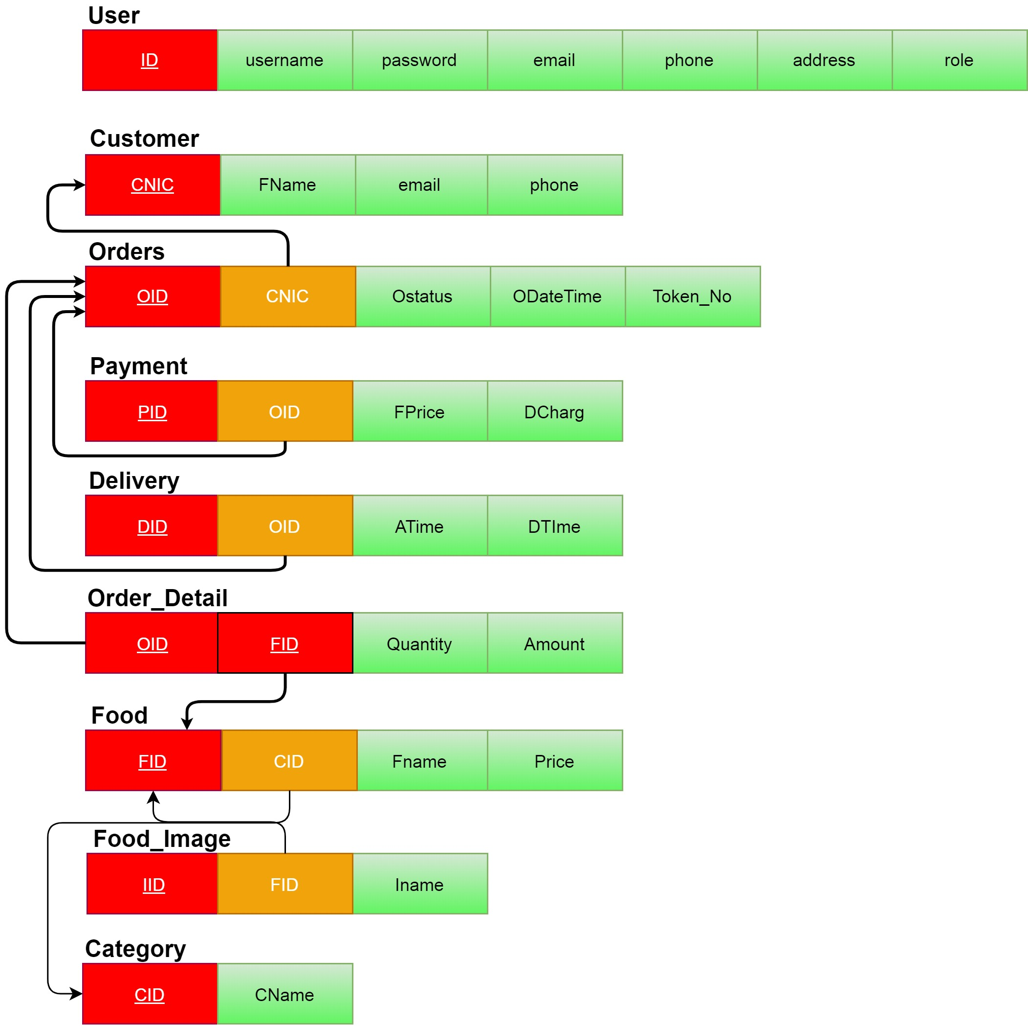

Slide 8
Thanks!

